Slide 1
WHAT’S NEW IN ENTITY FRAMEWORK CORE 2.1?
Chris Woodruff

Slide 2


Slide 3




Chris Woodruff
Developer Advocate at JetBrains
.NET, Data, Web
Chris.Woodruff@Jetbrains.com
www.facebook.com/chris.woodruff
www.twitter.com/cwoodruff
www.linkedin.com/in/chriswoodruff

Slide 4
Agenda
LINQ Like Function
Owned Entities
Global Query Filters
DbContext Pooling
String interpolation in raw SQL methods
Explicitly compiled queries
Database scalar function mapping
Data Seeding
Lazy Loading
LINQ Groupby

Slide 5
Entity Framework Core 2.0 Goals
.NET Standard 2.0
Quality
Performance
Close feature gap with EF 6
Reusable building blocks

Slide 6
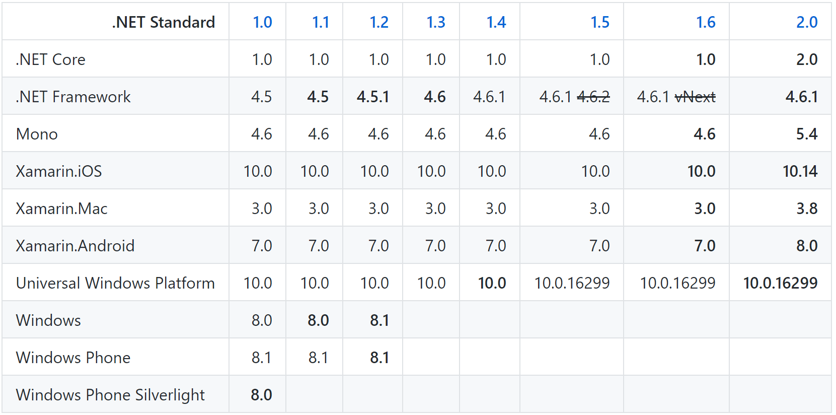
.NET Standard 2.0

Slide 7
LINQ Like Function
EF Core 2.0

Slide 8
Like Query Operator
var customers = from c in context.Customers where EF.Functions.Like(c.Name, "a%"); select c;
SELECT .[Id], .[Name] FROM [Customers] AS WHERE .[Name] LIKE N'a%';
EF Core 2.0
Notes:
You can now use EF.Functions.Like() in a LINQ query and it will be translated to LIKE in SQL or evaluated in memory if necessary. E.g. the following query:

Slide 9
Demo

Slide 10
Owned Entities
EF Core 2.0

Slide 11
Owned Entities and Table Splitting
public class Customer
{
public int Id { get; set; }
public string Name {get; set;}
public PhysicalAddress Address { get; set; }
}
public class PhysicalAddress
{
public string StreetAddress { get; set; }
public Location Location { get; set; }
}
...
modelBuilder.Entity<Customer>().OwnsOne(c => c.Address);
EF Core 2.0
Notes:
You can now define “owned” or “child” entities which group properties within other entities, very similar to how complex types used to work in EF6, but with the ability to contain reference navigation properties. In combination with table splitting, owned types allow these two entities to be automatically mapped to a single Customer table:

Slide 12
Global Query Filters
EF Core 2.0

Slide 13
Global Query Filters
modelBuilder.Entity<Post>().HasQueryFilter(p => !p.IsDeleted);
var blog = context.Blogs .Include(b => b.Posts) .FirstOrDefault(b => b.Id == id);
EF Core 2.0
Notes:
You can now specify filters in the model that are applied automatically to all entities of a type in all queries executed on the DbContext. E.g. given this code in OnModelCreating:

Slide 14
Demo

Slide 15
DbContext Pooling
EF Core 2.0

Slide 16
DbContext Pooling
DI Container
public class BlogsController : Controller
{
private BlogContext _context;
public BlogsController(BlogContext context)
{
_context = context;
}
public IActionResult Index()
{
return _context.Blogs.ToList();
}
}
Request: /blogs/index
Scope
BlogContext
Blogs
Controller
Request: /blogs/index
Scope
BlogContext
Blogs
Controller
Request: /blogs/index
Scope
BlogContext
Blogs
Controller
Notes:
Many ASP.NET Core applications can now obtain a performance boost by configuring the service registration of their DbContext types to use a pool of pre-created instances, avoiding the cost of creating new instance for every request:

Slide 17
DbContext Pooling
DI Container
public class BlogsController : Controller
{
private BlogContext _context;
public BlogsController(BlogContext context)
{
_context = context;
}
public IActionResult Index()
{
return _context.Blogs.ToList();
}
}
Request: /blogs/index
Context Pool
Scope
BlogContext
BlogContext
Scope
Blogs
Controller
BlogContext
BlogContext
BlogContext
Request: /blogs/index
BlogContext
BlogContext
Blogs
Controller
Scope
Request: /blogs/index
Scope
BlogContext
Blogs
Controller

Slide 18
DbContext Pooling
services.AddDbContext<BloggingContext>( options => options.UseSqlServer(connectionString));
services.AddDbContextPool<BloggingContext>( options => options.UseSqlServer(connectionString));
EF Core 2.0

Slide 19
Demo

Slide 20
String interpolation in raw SQL methods
EF Core 2.0

Slide 21
String interpolation in raw SQL methods
var city = "Redmond";
using (var context = CreateContext())
{
context.Customers.FromSql($@“
SELECT *
FROM Customers
WHERE City = {city}");
}
SELECT *
FROM Customers
WHERE City = @p0
SELECT *
FROM Customers
WHERE City = ‘Redmond’
EF Core 2.0

Slide 22
Explicitly Compiled Queries
EF Core 2.0

Slide 23
Explicitly Compiled Queries
static readonly Func<MyEntityContext, int, IEnumerable<MyEntity>>
CompiledQuery =
EF.CompileQuery<MyEntityContext, int, MyEntity>((ctx, id) =>
ctx.MyEntities.Where(x => x.Id == id).Include(x => x.Others).OrderBy(x => x.Name));
var results = CompiledQuery(ctx, 100).ToList();
EF Core 2.0
Notes:
Entity Framework Core included query caching since version 1, but there is still some overhead associated with calculating the key from the query and getting it from the cache. Therefore, version 2 introduced a capability that existed in LINQ to SQL and Entity Framework pre-Core: explicit query compilation and execution. By this, we are able to pre-compile a query and use it in whatever context we want (of a compatible type, of course). We can even eagerly fetch associated collections or entities:

Slide 24
Demo

Slide 25
Database scalar function mapping
EF Core 2.0

Slide 26
Database Scalar Function Mapping
public class BloggingContext : DbContext {
[DbFunction]
public static int PostReadCount(int blogId)
{
throw new Exception();
}
}
var query = from p in context.Posts
where BloggingContext.PostReadCount(p.Id) > 5
select p;
EF Core 2.0

Slide 27
Data Seeding

Slide 28
Entity Constructor Parameters
public class Blog { public int BlogId { get; set; } public string Url { get; set; } public List<Post> Posts { get; set; } = new List<Post>(); }

Slide 29
Entity Constructor Parameters
public class Blog { public Blog(int blogId, string url) { BlogId = blogId; Url = url; } public int BlogId { get; set; } public string Url { get; set; } public List<Post> Posts { get; set; } = new List<Post>(); }

Slide 30
Data Seeding Example
private void DataSeeding(ModelBuilder modelBuilder) { modelBuilder.Entity<Vendor>().HasData( new Vendor { BusinessEntityID = 1, AccountNumber = "838383", Name = "Acme Products", CreditRating = 4, PreferredVendorStatus = false, ActiveFlag = true }); }

Slide 31
Lazy Loading

Slide 32
Lazy Loading Example
Install the Microsoft.EntityFrameworkCore.Proxies NuGet package
Either way to enabling:
protected override void OnConfiguring(DbContextOptionsBuilder optionsBuilder) { optionsBuilder.UseLazyLoadingProxies(). UseSqlServer(myConnectionString); }
services.AddDbContext<ChinookContext>( options => options.UseSqlServer(connection).UseLazyLoadingProxies() );
Notes:
EF Core will then enable lazy loading for any navigation property that can be overridden--that is, it must be virtual and on a class that can be inherited from.

Slide 33
LINQ GroupBy

Slide 34
LINQ GroupBy
var query = context.Orders
.GroupBy(o => new { o.CustomerId, o.EmployeeId })
.Select(g => new
{ g.Key.CustomerId,
g.Key.EmployeeId,
Sum = g.Sum(o => o.Amount),
Min = g.Min(o => o.Amount),
Max = g.Max(o => o.Amount),
Avg = g.Average(o => Amount)
}
);
SELECT [o].[CustomerId], [o].[EmployeeId], SUM([o].[Amount]), MIN([o].[Amount]), MAX([o].[Amount]), AVG([o].[Amount])
FROM [Orders] AS [o]
GROUP BY [o].[CustomerId], [o].[EmployeeId];

Slide 35
Things to know
EF Core 2.1 won’t be binary compatible with EF Core 1.0
The minimum version of .NET Framework supported is 4.6.1
The minimum version of Xamarin.iOS supported is 10.14
The minimum version of Xamarin.Android supported is 8.0
The minimum version of UWP supported is 10.0.16299
Spatial Data Types high priority for EF Core 2.2
Working with Views may happen in EF Core 3.0
Stored Procedures native support not support but work arounds using string interpolation in raw SQL methods

Slide 36
More information?
Docs https://docs.microsoft.com/ef/core
Project https://github.com/aspnet/EntityFrameworkCore
Blog https://blogs.msdn.microsoft.com/dotnet/
Demos https://github.com/cwoodruff/EFCore21Demos

Slide 39
Chris Woodruff
https://github.com/cwoodruff/EFCore21Demos
Developer Advocate at JetBrains
.NET, Data, Web
Chris.Woodruff@Jetbrains.com
www.facebook.com/chris.woodruff
www.twitter.com/cwoodruff
www.linkedin.com/in/chriswoodruff

